Slide 1
Large-Scale and Multi-Structured Databases
Project Design
Nexus Scholar
Andrea Covelli
Daniele Congiusti
Luca Giannini

Slide 2
Application Highlights
The idea consists of creating a platform dedicated to analyzing a wide database of scientific papers of all types, which allows users to identify and view hidden connections in the field of research.
We will offer such powerful analytics, the implementation of which is not easy in traditional databases. Here are some examples:
  Discover researchers and most influential papers using ranking algorithms (i.e. Pagerank)
  Figure out shortest collaboration paths between two researchers (Erdős number)
  Analyze research trends emerging over time
Notes:
ROBA IN ITALIANO:
- L'idea è creare una piattaforma per analizzare un vasto database di pubblicazioni scientifiche di vario genere, permettendo di scoprire e visualizzare le connessioni nascoste nel mondo della ricerca.
Le analisi offerte saranno molto potenti (difficilmente effettuabili con un database tradizionale) come ad esempio:
Identificare i ricercatori e gli articoli più ‘’influenti‘’ usando algoritmi di ranking (i.e. PageRank).
Scoprire i percorsi di collaborazione più brevi tra due scienziati (numero di Erdős).
Analizzare i trend di ricerca emergenti nel tempo.

Slide 3

Actors
Search papers by title, keywords, or author
View basic author profiles
Restricted analysis
may do
Unregistered user
All unregistered user permissions
Visualize citation networks
View Trend Analysis
Save searches
may do
Registered user
Manage users
Monitor database
Trigger data ingestion
may do
Administrator

Slide 4
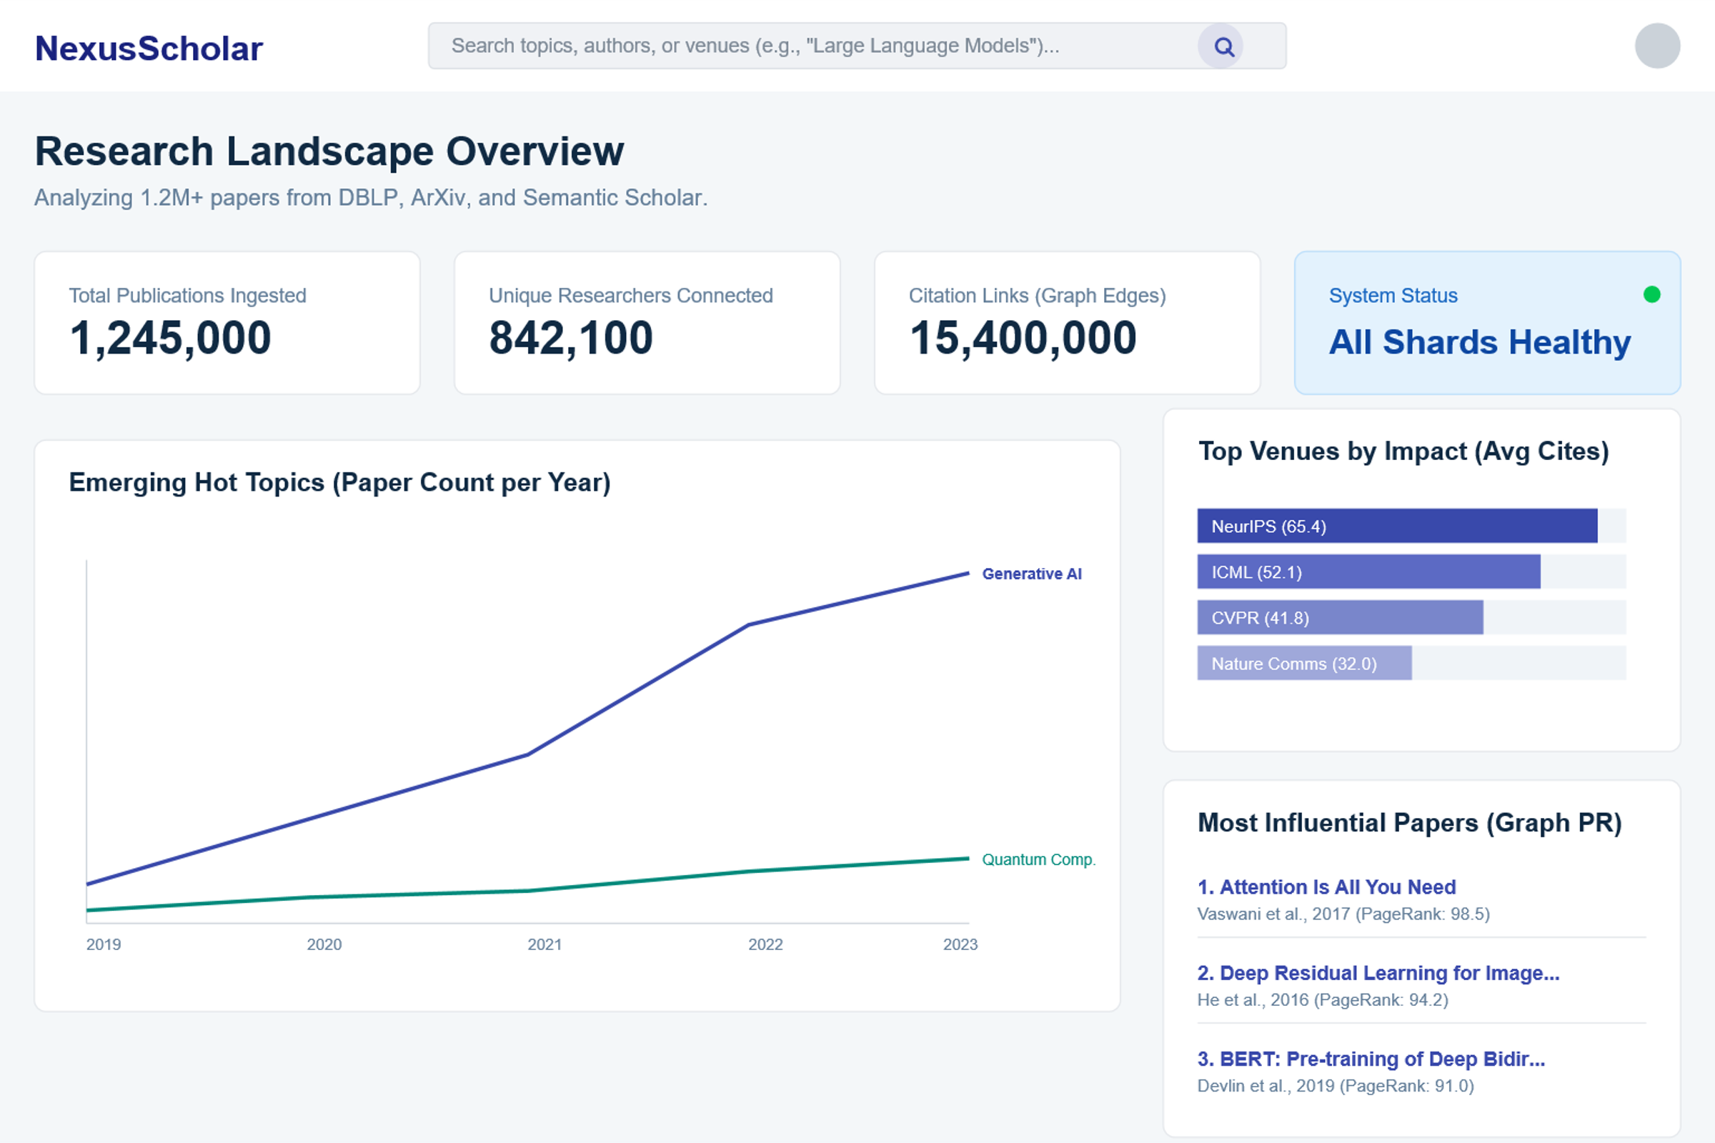
Main mock-ups (i)

Slide 5
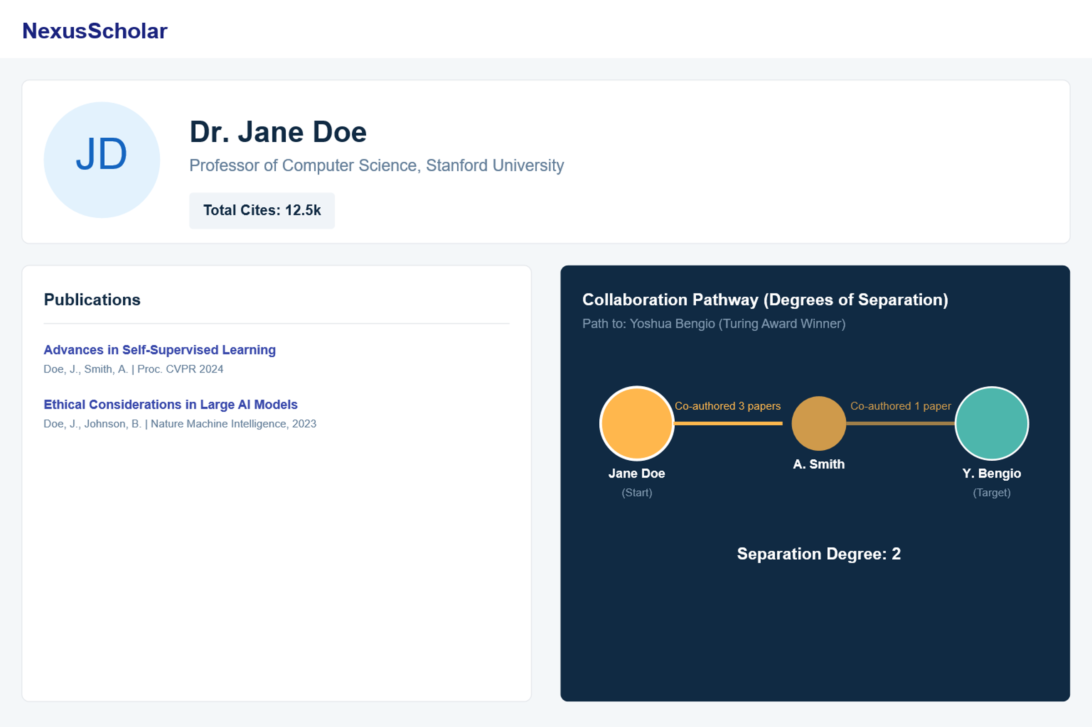
Main mock-ups (ii)

Slide 6


Dataset Description
Source: DBLP Computer Science Bibliography (XML Dump), Semantic Scholar (S2) API (JSON)
Description: DBLP provides comprehensive bibliographic information on computer science journals and proceedings. S2 offers pre-print access across various scientific fields.
Volume: High. DBLP dump is ~1GB containing:
Variety: Medium-High. Data from distinct sources (Dump vs. API) and formats (XML and JSON)
Velocity/Variability: Low-Medium. DBLP provides monthly dumps. Semantic Scholar has higher velocity (daily updates)
+6 mln publications
+3 mln authors

Slide 7
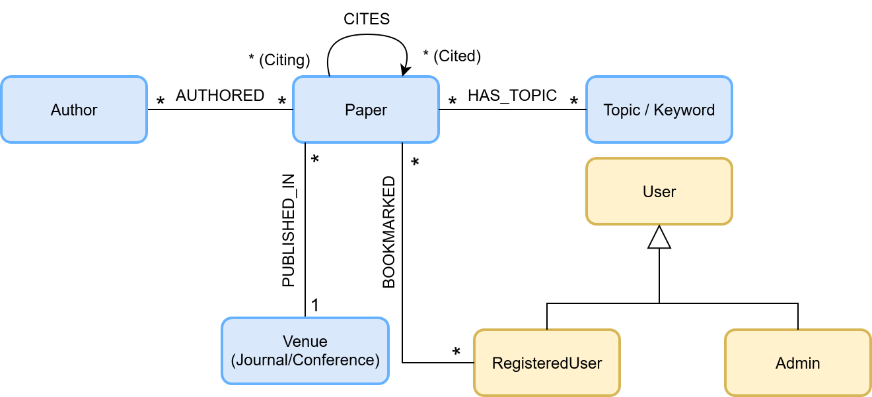
Preliminary UML Class Diagram

Slide 8
Relevant Queries and Entities handled by Document DB
Trend Analysis (Hot Topics): Calculate the number of papers published per Topic per year, segmented by source (DBLP vs Semantic Scholar). This identifies emerging research trends.
Prolific Author Identification: Find authors who have published in more than 5 distinct keywords/topics within a single year, identifying interdisciplinary researchers.
Entities stored in documentDB:
Paper
Author
Topic
Venue
Registered User
Admin
Notes:
Evaluate use a parameter

Slide 9
Requirements and Entities handled by Graph DB
Influential Paper Identification (Graph-Centric): Run the PageRank algorithm (available in the Neo4j GDS library) on the :CITES network. This identifies the most structurally important papers in the dataset.
Collaboration Pathway / Erdős Number (Domain-Specific): Find the shortest path between two Author nodes using co-authorship (derived from the :AUTHORED relationship). This shows the degrees of separation between researchers. (Uses the shortestPath algorithm).
Entities stored in graphDB:
Paper
Author
Topic

Slide 10
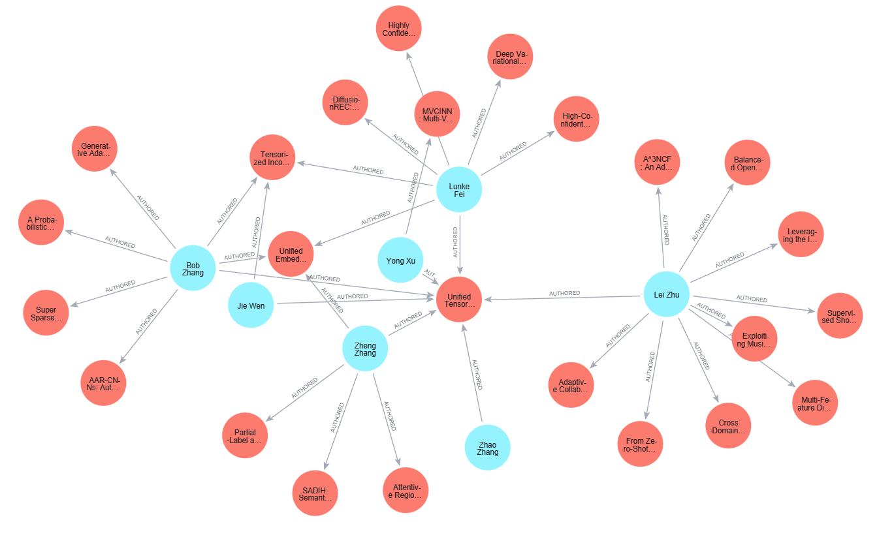
Snapshots from GraphDB (i)

Slide 11
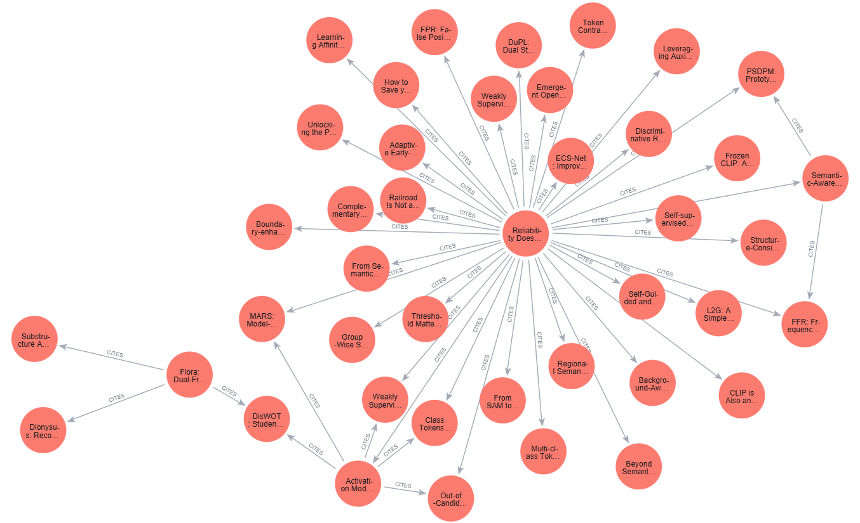
Snapshots from GraphDB (ii)

Slide 12
Non functional requirements (added by us not in the template )
Useremo un'architettura a due database NoSQL (Polyglot Persistence):
1. MongoDB (Document DB): Sarà il nostro "archivio di contenuti". Salveremo i dettagli di ogni singolo paper (titolo, abstract, autori, anno, parole chiave) come documenti JSON.
2. Neo4j (Graph DB): Sarà il nostro "motore di relazioni". Mapperemo la rete di collegamenti tra le entità:
- Un paper CITA un altro paper.
- Un autore HA SCRITTO un paper.
- Un autore HA COLLABORATO CON un altro autore.
Venue Impact Analysis: Calculate the average citation_count for papers, grouped by venue_name and year, to assess the impact of different publication venues.

